Slide 1
ACS
BUSINESS PROCESS SERVICES
Reliable operations are built by design
We assess, build, and support the processes and systems behind your work.
Affiliated Corporate Services, LLC · North Carolina
Notes:
Source: https://acsllc-nc.com/. ACS service descriptions are paraphrased from the current website. Images on this slide, if any, came from the user-provided ACS pitch deck.

Slide 2
WHAT ACS DOES
One purpose, six connected services
OPERATIONS
SOPS & TRAINING
Process mapping and management
Instructions people can use
QUALITY
FACILITIES
Standards, inspection, and recovery
Scope, estimating, and oversight
WEB & DIGITAL
SOFTWARE
Full websites, Starter Sites, local presence
Tools built around client workflows
Explore the Resource Center and Small Business Brief at acsllc-nc.com.
ACS BUSINESS PROCESS SERVICES
02
Notes:
Source: https://acsllc-nc.com/services. ACS service descriptions are paraphrased from the current website. Images on this slide, if any, came from the user-provided ACS pitch deck.

Slide 3
OUR APPROACH
We start with the work as it happens
01
02
03
ASSESS
BUILD
SUPPORT
Observe workflow, define the problem, and establish a baseline.
Create the process, training, control, site, or software the work requires.
Check results with the client and refine what needs to change.
ACS BUSINESS PROCESS SERVICES
03
Notes:
Source: https://acsllc-nc.com/about. ACS service descriptions are paraphrased from the current website. Images on this slide, if any, came from the user-provided ACS pitch deck.

Slide 4
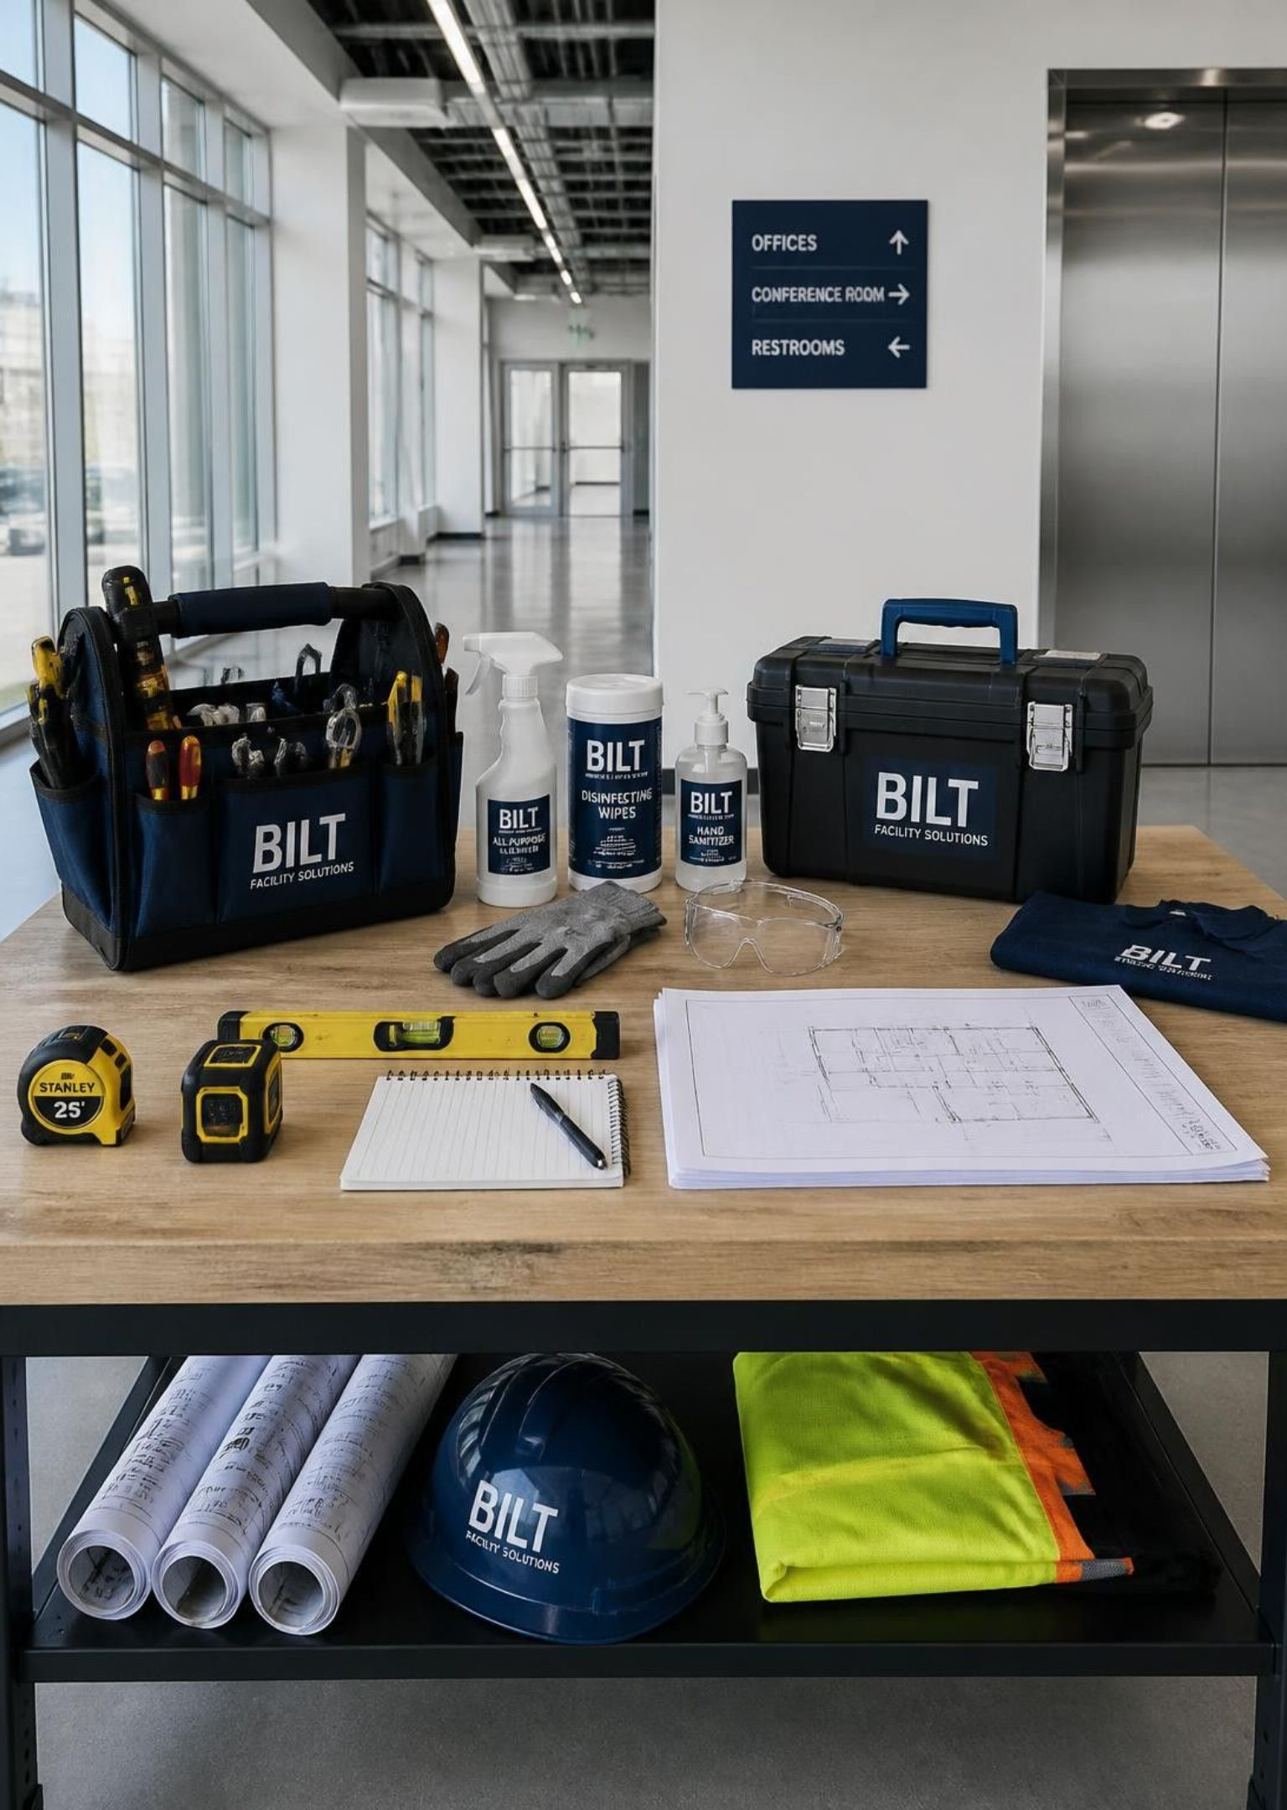
OPERATIONS & PROCESSES
Clear processes reduce avoidable rework
WHERE WORK BREAKS DOWN
Unclear handoffs, undocumented decisions, and recurring exceptions make a good team work harder than it should.
WHAT ACS CAN BUILD
A practical workflow map with owners, decision points, measures, and an improvement plan the team can follow.
ACS BUSINESS PROCESS SERVICES
04
Notes:
Source: https://acsllc-nc.com/services. ACS service descriptions are paraphrased from the current website. Images on this slide, if any, came from the user-provided ACS pitch deck.

Slide 5
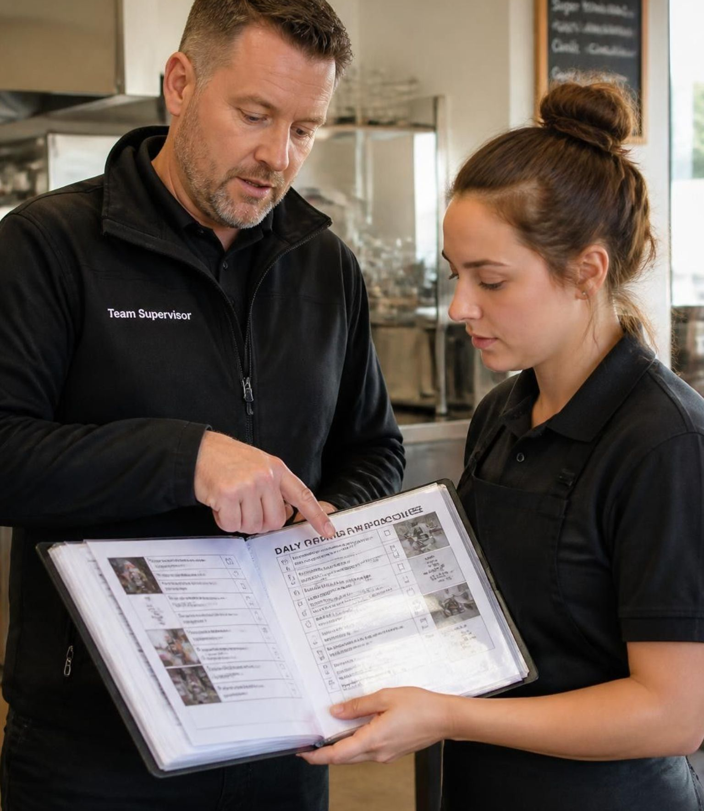
SOPS & TRAINING
Instructions work when people can use them
DOCUMENT
Write procedures around the actual task and its exceptions.
TRAIN
Turn the procedure into job aids, onboarding, and practice.
VERIFY
Check that the team can perform the work consistently.
ACS BUSINESS PROCESS SERVICES
05
Notes:
Source: https://acsllc-nc.com/services. ACS service descriptions are paraphrased from the current website. Images on this slide, if any, came from the user-provided ACS pitch deck.

Slide 6
QUALITY & INSPECTION
Quality becomes manageable when it is visible
Define what good performance looks like before the inspection. Record findings, assign corrective action, and verify that the fix holds.
SET THE STANDARD
Specific criteria and an agreed inspection method
RECORD THE RESULT
Scored observations and a usable history
CLOSE THE LOOP
Ownership, follow-up, and prevention of repeat failures
ACS BUSINESS PROCESS SERVICES
06
Notes:
Source: https://acsllc-nc.com/services. ACS service descriptions are paraphrased from the current website. Images on this slide, if any, came from the user-provided ACS pitch deck.

Slide 7
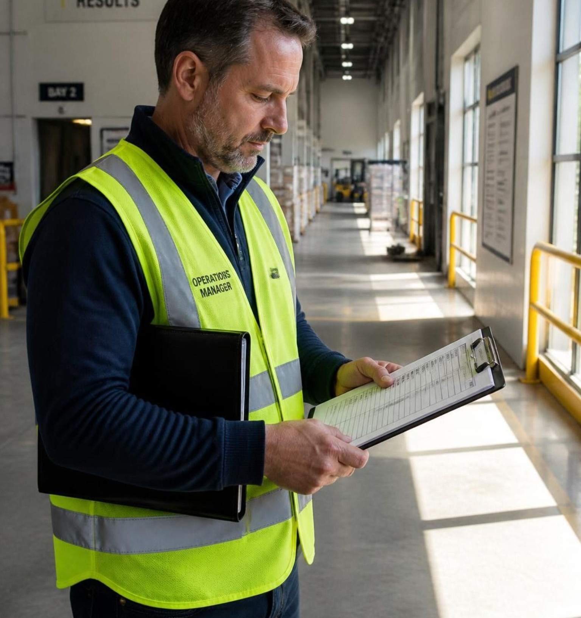
FACILITY SERVICES FOR OWNERS
Facility scopes need defensible labor models
FROM THE BUILDING TO THE BID
01
Measure cleanable area and classify the space.
02
Define tasks and frequency by area.
03
Build a labor model from production rates with documented adjustments.
04
Use the scope to compare proposals and oversee performance.
ACS BUSINESS PROCESS SERVICES
07
Notes:
Source: https://acsllc-nc.com/services. ACS service descriptions are paraphrased from the current website. Images on this slide, if any, came from the user-provided ACS pitch deck.

Slide 8
FACILITY SERVICES FOR CONTRACTORS
Contractors need the same operational discipline
ACS supports building service contractors with workloading, production-rate analysis, bid review, account assessments, and management systems.
TYPICAL DELIVERABLES
BID SUPPORT
ACCOUNT REVIEW
MANAGEMENT TOOLS
Check scope, hours, and assumptions before pricing.
Find where current performance or margin is slipping.
Put periodic tasks and quality checks on a documented schedule.
ACS BUSINESS PROCESS SERVICES
08
Notes:
Source: https://acsllc-nc.com/services. ACS service descriptions are paraphrased from the current website. Images on this slide, if any, came from the user-provided ACS pitch deck.

Slide 9
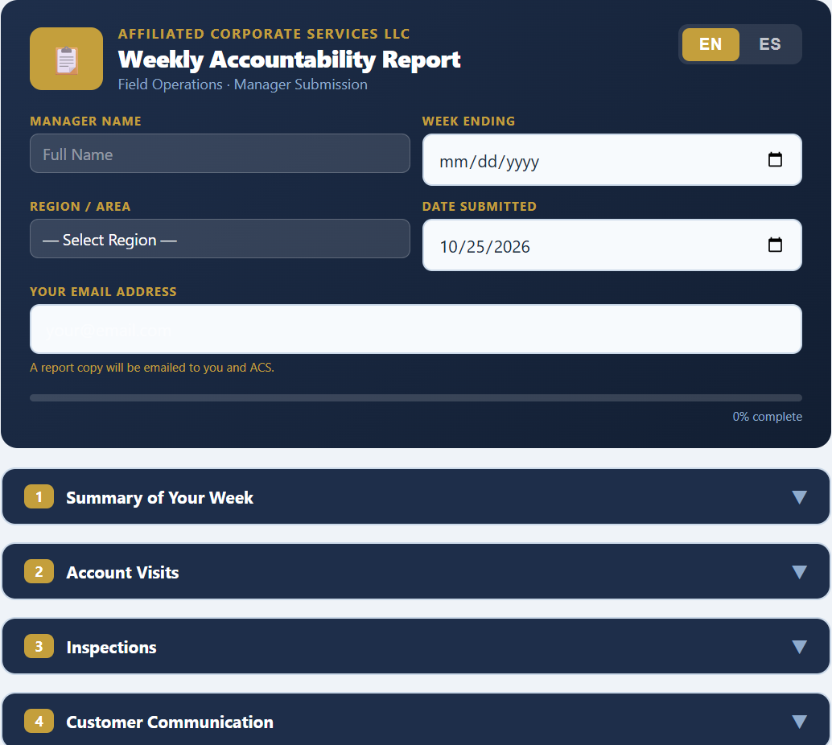
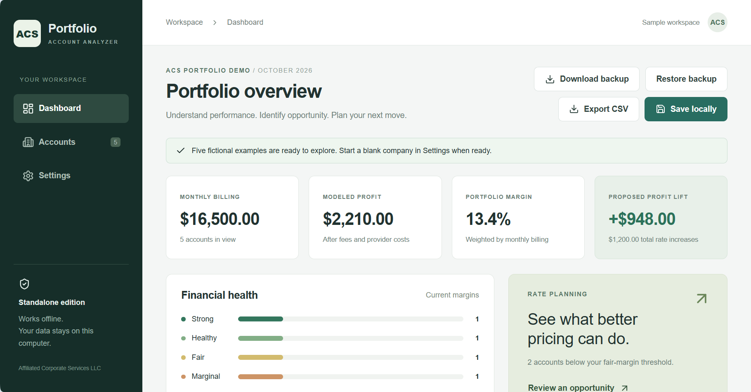
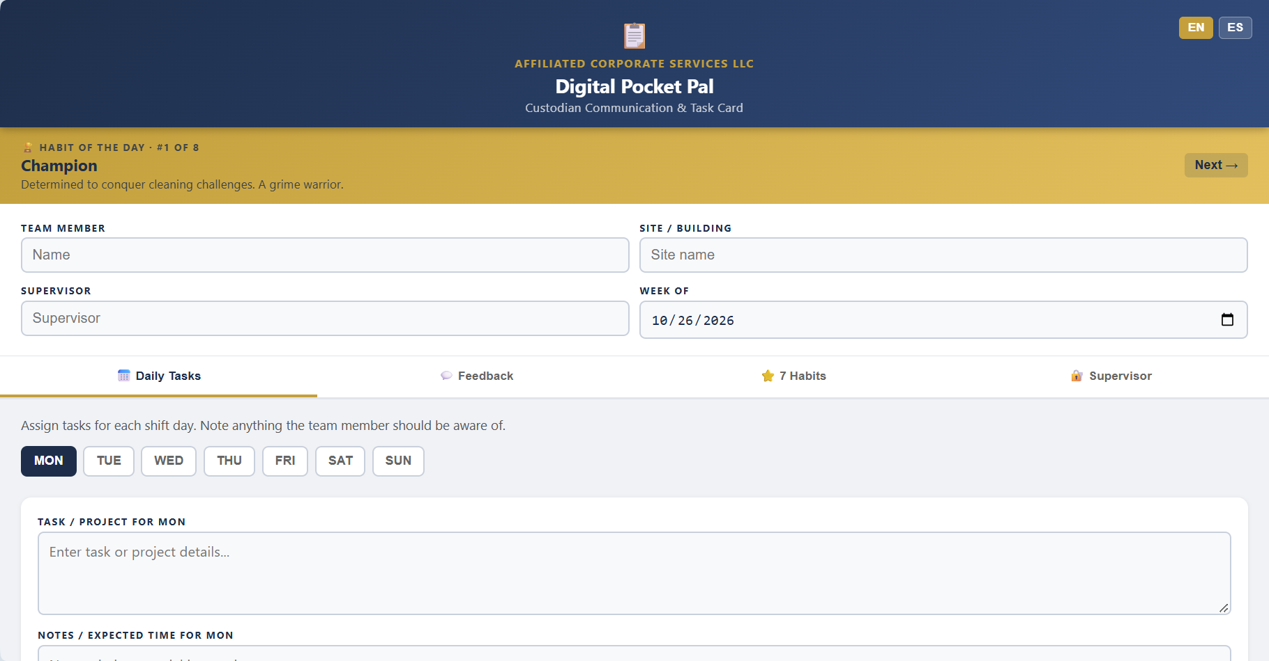
CUSTOM SOFTWARE
Software built around your business
Account Portfolio Analyzer
Weekly Accountability Report
Digital Pocket Pal
Review account margins and model pricing changes.
Document weekly activity, inspections, and customer follow-up.
Organize daily tasks and support communication with supervisors.
Each example can be adapted to your workflows, branding, reporting, and operational needs.
ACS BUSINESS PROCESS SERVICES
09
Notes:
Screenshots supplied by Al Summers: ACS Account Portfolio Analyzer (sample data), Weekly Accountability Report, and Digital Pocket Pal. These examples show existing ACS software that can be adapted to customer needs. Features and any integrations are defined in an agreed project scope.

Slide 10

WEBSITES & DIGITAL PRESENCE
Full websites are part of the offering
ACS builds professional, multi-page websites for established businesses. The scope can include service pages, clear calls to action, and a site structure that supports future growth.
CLIENT CONTROL
The domain and core digital accounts stay under the client’s control. Ongoing management is optional.
ACS BUSINESS PROCESS SERVICES
10
Notes:
Source: https://web.acsllc-nc.com/. ACS service descriptions are paraphrased from the current website. Images on this slide, if any, came from the user-provided ACS pitch deck.

Slide 11
STARTER SITES & LOCAL PRESENCE
Two more paths to a useful online presence
STARTER SITES
LOCAL PRESENCE
A defined website scope for a business that needs a credible starting point and a straightforward launch.
Support for the business information customers encounter in local search and online listings, alongside the website.
ACS defines the work in a written proposal before payment.
ACS BUSINESS PROCESS SERVICES
11
Notes:
Source: https://web.acsllc-nc.com/. ACS service descriptions are paraphrased from the current website. Images on this slide, if any, came from the user-provided ACS pitch deck.

Slide 12
ILLUSTRATIVE ENGAGEMENT
One problem can call for several capabilities
A service business sees repeat customer complaints even though staff complete the assigned tasks.
DIAGNOSE
STANDARDIZE
MEASURE
FOLLOW UP
Review the work and the customer experience.
Clarify the SOP and train the team.
Use inspection criteria and a simple tracking tool.
Check whether the customer sees a better result.
Illustrative example, not a client case study
ACS BUSINESS PROCESS SERVICES
12
Notes:
Source: https://acsllc-nc.com/. ACS service descriptions are paraphrased from the current website. Images on this slide, if any, came from the user-provided ACS pitch deck.

Slide 13
A PRACTICAL FIRST STEP
Start with a complimentary assessment
Choose a broad Small Business Systems Assessment or a focused review of an area that needs attention.
WHAT YOU RECEIVE
Written findings and practical next steps
One complimentary assessment per eligible business. No obligation to purchase an ACS service.
ACS BUSINESS PROCESS SERVICES
13
Notes:
Source: https://acsllc-nc.com/assessment. ACS service descriptions are paraphrased from the current website. Images on this slide, if any, came from the user-provided ACS pitch deck.

Slide 14
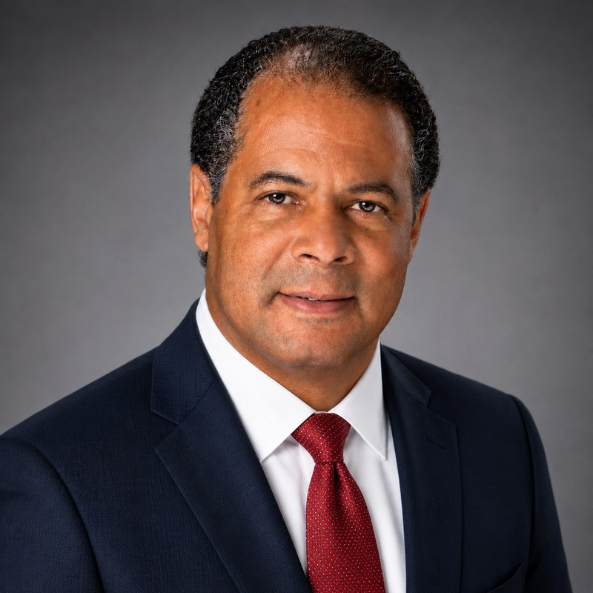

MEET AL SUMMERS
Purpose into practice
Al Summers
Owner, Affiliated Corporate
Services, LLC
Registered Building Service Manager, Building Service Contractors Association International
Facility management consultation and contract oversight
Production-rate-based estimating and labor modeling
Scope development, bid analysis, and quality auditing
ACS BUSINESS PROCESS SERVICES
14
Notes:
Source: https://acsllc-nc.com/about. Portrait and RBSM badge came from the ACS website source. The Purpose Into Practice diagram was recreated from the user-provided reference graphic to fit this slide without cropped edges.

Slide 15
ACS
Let’s talk about the work you need to improve
Share the current problem, who uses the process or system, and what a better result would look like.
acsllc-nc.com
info@acsllc-nc.com • 336.338.3454
Notes:
Source: https://acsllc-nc.com/contact. ACS service descriptions are paraphrased from the current website. Images on this slide, if any, came from the user-provided ACS pitch deck.

